Slide 1
G PRIYADHARSHINI
Final Project
3/21/2024 Annual Review

Slide 2
SIGN LANGUAGE RECOGNITION Sign language recognition refers to the process of converting sign language gestures into written or spoken language. This can involve using technology such as cameras or sensors to capture the gestures and then using machine learning algorithms to interpret and translate them. The goal is to enable communication between sign language users and non-signers, as well as to facilitate access to information and services for the deaf and hard of hearing community.
3/21/2024 Annual Review

Slide 3


AGENDA 1.Research and Understanding 2.Data Collection and Preparation 3.Feature Extraction 4.Model Selection and Training 5. Evaluation and Testing 6. Optimization and Refinement 7. Deployment
3/21/2024 Annual Review

Slide 4

PROBLEM STATEMENT A Normal person if visits a mute person and tries to communicate with him, will face difficulties in trying to understand what a mute person is trying to express. The system should be able to recognize a predefined set of ASL gestures representing letters, numbers, and common words. The goal is to create a user-friendly application that can help bridge the communication gap between sign language users and non-signers.
3/21/2024 Annual Review

Slide 5
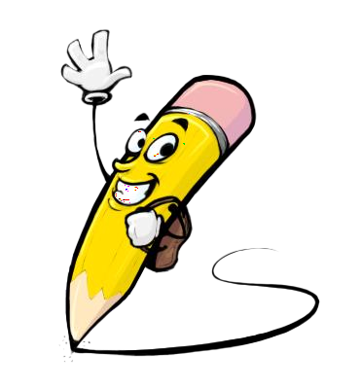
PROJECT OVERVIEW This project focuses on recognizing American Sign Language (ASL) gestures, including letters, numbers, and common words. The project involves collecting a dataset of ASL gestures, preprocessing the data to extract relevant features, and training a machine learning model to recognize these gestures. Key steps in the project include dataset collection and preparation, preprocessing, feature extraction, model selection and training, model evaluation, real-time recognition implementation using OpenCV, user interface development, testing, optimization, and deployment.
3/21/2024 Annual Review

Slide 6


WHO ARE THE END USERS? 1. Deaf or Hard of Hearing Individuals 2. Interpreters and Educators 3. Family Members and Friends 4. Healthcare Professionals 5. Technology Developers 6. General Public
3/21/2024 Annual Review

Slide 7

YOUR SOLUTION AND ITS VALUE PROPOSITION
Real-time Communication
User-Friendly Interface
Accessibility and Inclusivity
Accuracy and Reliability
Education and Awareness
3/21/2024 Annual Review

Slide 8

THE WOW IN YOUR SOLUTION The best solution for sign language recognition typically involves a combination of advanced techniques and technologies to achieve high accuracy and real-time performance. A comprehensive solution for sign language recognition can achieve high accuracy, real-time performance, and accessibility for users of sign language.
3/21/2024 Annual Review

Slide 9
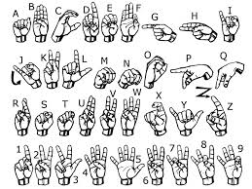
MODELLING
Teams cam add wireframes
3/21/2024 Annual Review

Slide 10
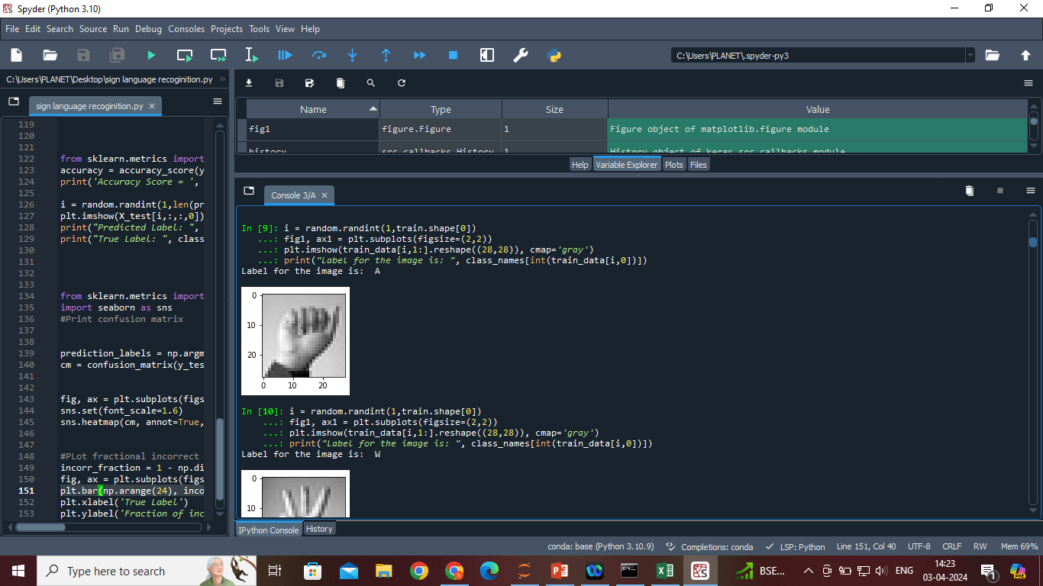
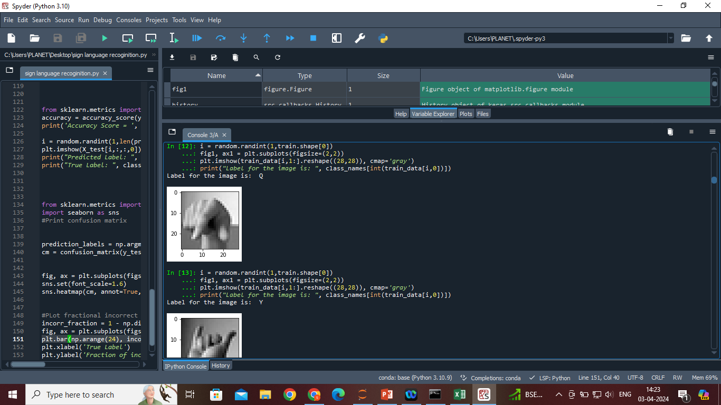
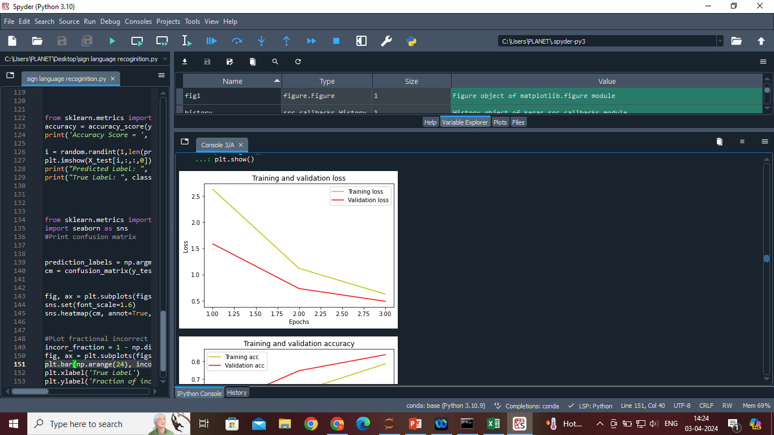
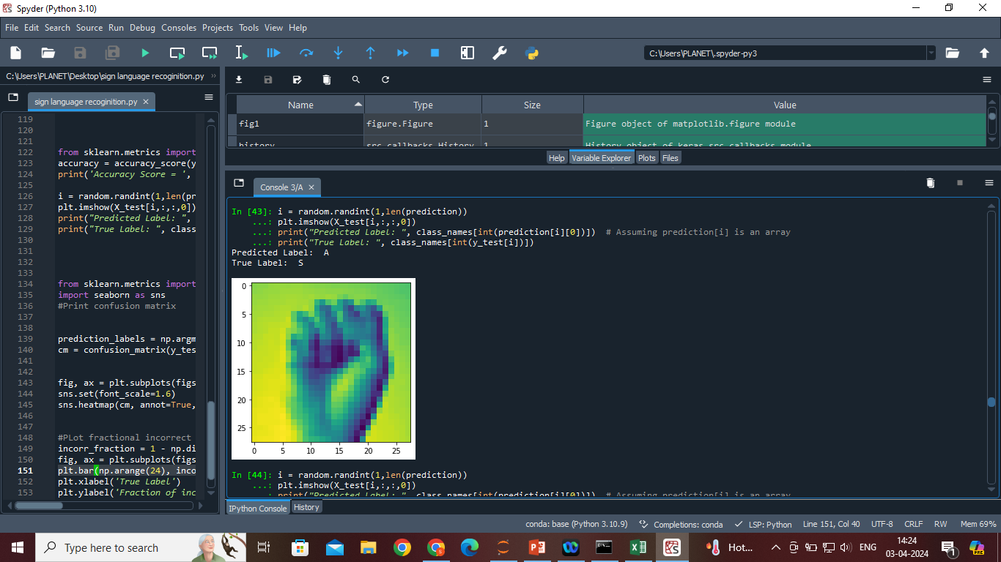
RESULTS
Demo Link
3/21/2024 Annual Review

